Slide 1
Sensation
Interacting with our environment

Slide 2
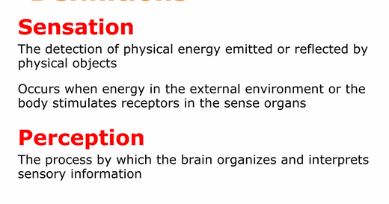

Slide 3
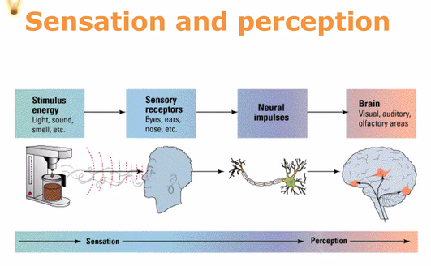

Slide 4

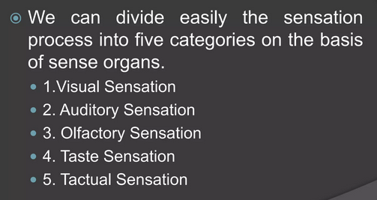

Slide 5
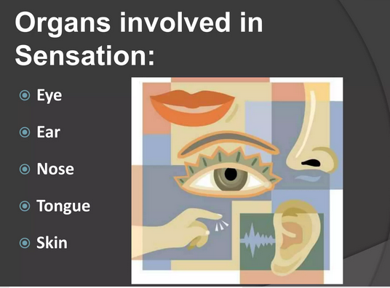

Slide 6
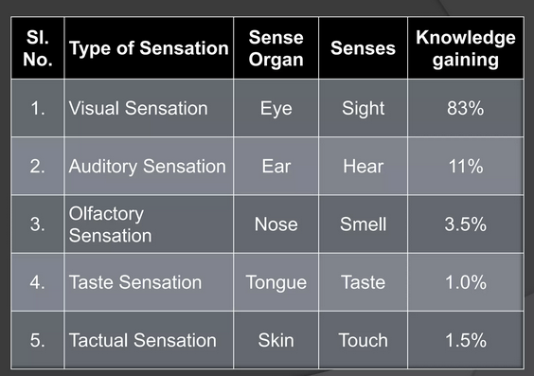

Slide 7
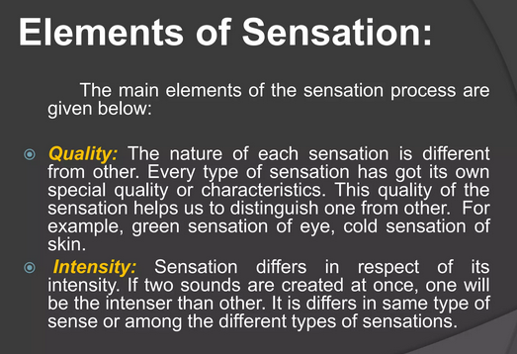

Slide 8
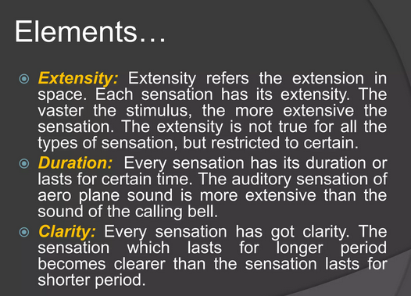

Slide 9
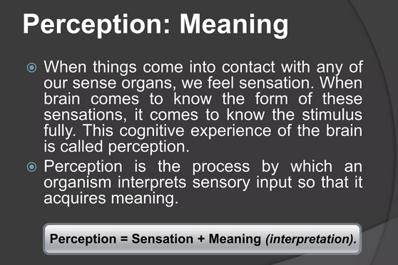

Slide 10
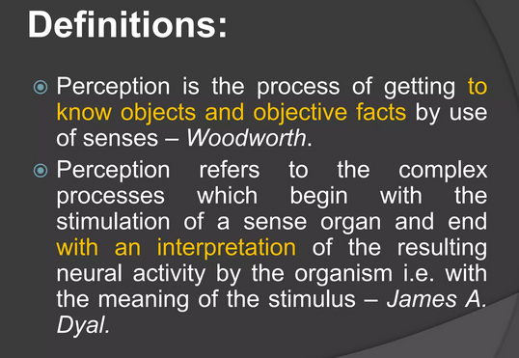

Slide 11
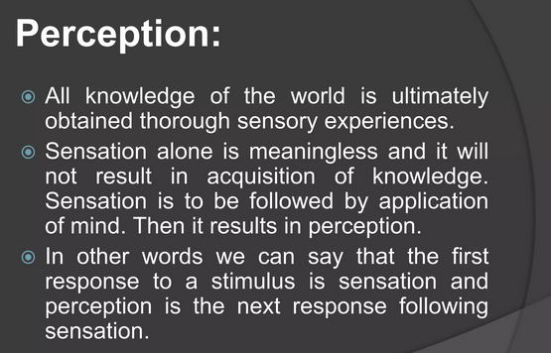

Slide 12
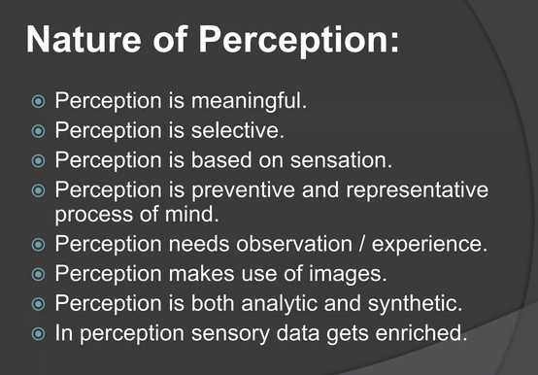

Slide 13
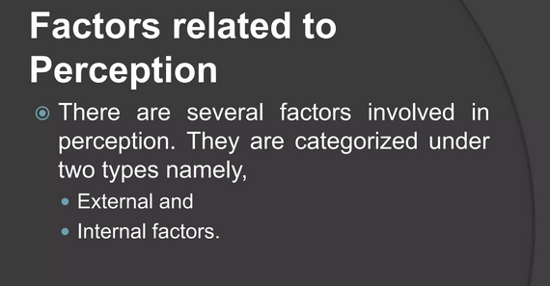

Slide 14
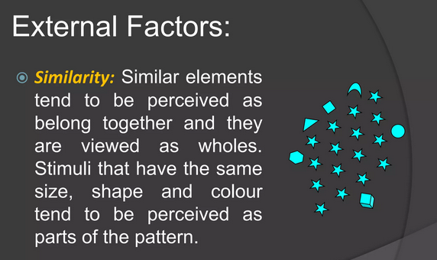

Slide 15
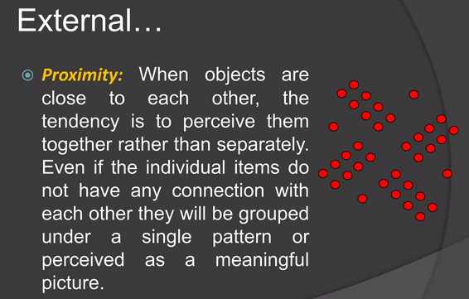

Slide 16
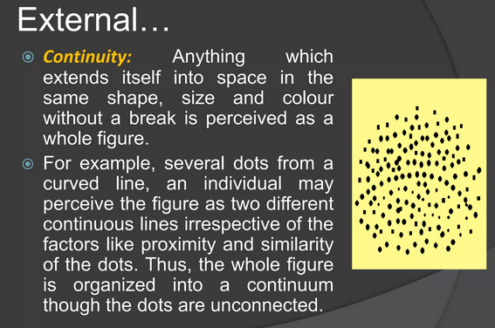

Slide 17
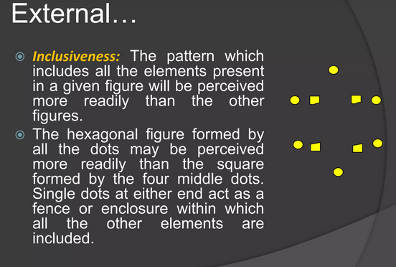

Slide 18
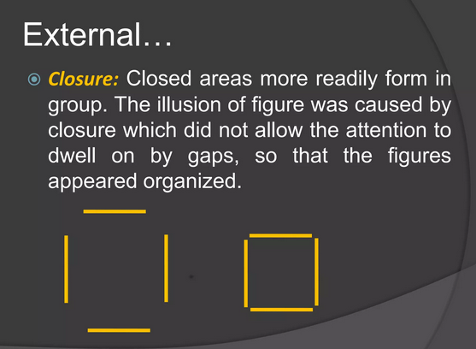

Slide 19
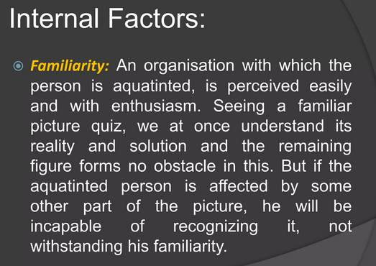

Slide 20
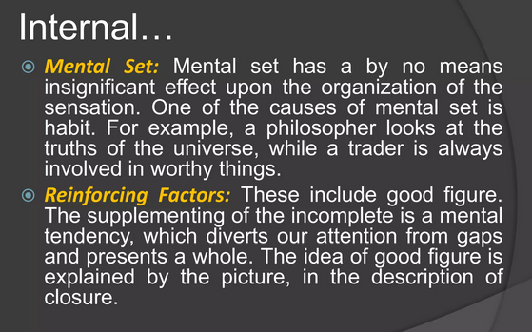

Slide 21
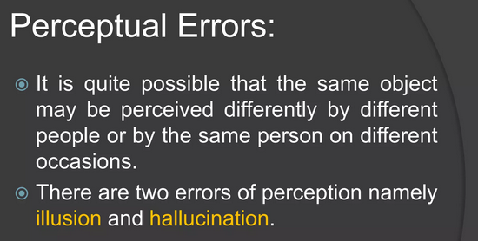

Slide 22
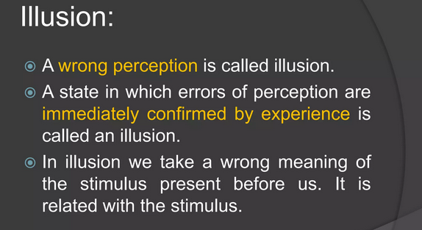

Slide 23
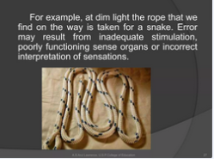

Slide 24
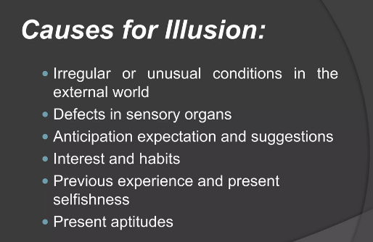

Slide 25
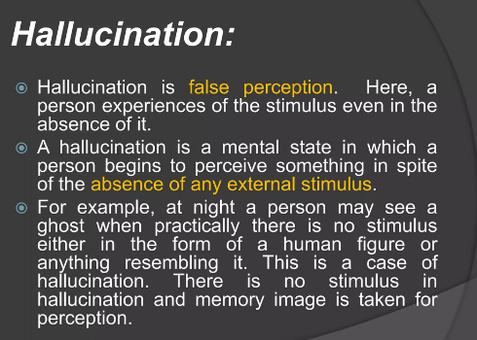

Slide 26
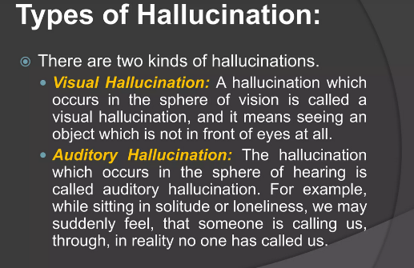

Slide 27
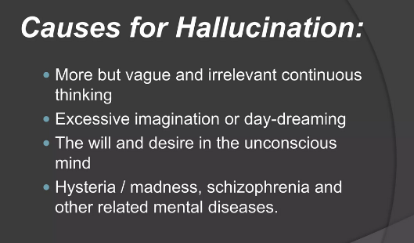

Slide 28
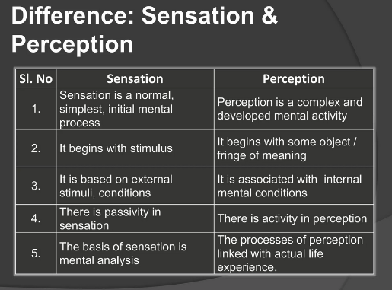

Slide 29
What’s the difference?
Sensation
Interaction between the body-environment
the reception of physical stimulation.
Use of specialized cells.
Perception
our interpretation
active decoding process
influenced by
  experience
  thoughts
  beliefs...

Slide 30

The 6 Senses
Vision
Olfactory
Taste
Tactile
Kinesthetic
Auditory

Slide 31
Keeping Homeostasis
Receiving Information
  Absolute threshold
    Signal Detection theory
  Difference threshold
    jnd
    sub- & supra- liminal messages
      priming effects “RATS”
Sensory Adaptation

Slide 32
Theories of Sensation
Physical Stimuli
Basic Function
Current Theories

Slide 33

Seeing
Vision
wavelengths of light
saccades vs. tracking
Trichromatic Theory
Opponent-Process Theory

Slide 34
Chemical Brothers
Olfactory
dissolved chemical signals
  aromatherapy
weights of odorant
Stereochemical theory
  difficult to study
linked to memory
Taste
dissolve chemical signals
Papillae
Basic 4
  sweet
  sour
  salty
  bitter

Slide 35
Sensations & Balance
Tactile
largest organ
product of neural patterns
Homunculus
Gate-Control Theory
  differences in mylenation
  receptors in spinal cord
Kinesthetic & Vestibular
Cerebellum & receptors
the inner ear
linked to the other senses
  limbs in space
  motion sickness

Slide 36

Hearing
Auditory
sound waves….moving bones & hair
loudness : amplitude pitch : frequency
Place theory
Frequency theory

Slide 37
Perception
Interpretation of our experiences

Slide 38
What is Perception?
Selective
Organization
Interpretation

Slide 39

Organizing Principles
Figure-Ground
Grouping
Constancy
Patterns
Distance Cues

Slide 40
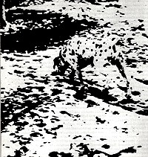
Gestalt Laws of Grouping
Similarity
Proximity
Continuation
Closure
Common Region
Simplicity
p. 115

Slide 41
Visual Distance Cues
Binocular
Convergence
Retinal Disparity
  stereograms
Monocular
Size
Linear
Texture
Atmospheric
Overlap
Height
MOTION PARALLAX

Slide 42
Q: How do Magic Eye 3-D Pictures Work?
A: Both stereograms and the magic eye pictures capitalize on a binocular depth cue called retinal or binocular disparity. Normally when we view a scene, objects at various distances project a slightly different image in the left and right eye. Hold your thumb about one inch away from your nose. Close one eye, and then the other. You will note that the view of your thumb changes depending on which eye you look at it with. The brain uses this disparate information to locate objects in depth. A stereogram "fools" the brain by presenting a slightly different view of a scene to each eye. The brain reconstructs the views, and objects appear at various distances. The magic eye pictures do the same thing except each view is a very high contrast dot diagram of the scene. Note that two images are presented. As you focus on the flat images, they appear to be just a swirl of dots – we are not getting any depth information. However, when you allow your eyes to un-focus, each panel presents a slightly different dot pattern to each eye. The disparity is integrated, and presto – an image appears.

Slide 43
Fooling the Mind
Illusions

Slide 44
Paris in the
the Spring

Slide 45
So, you think you’re a pretty
pretty good reader. Then I bet you
you see the problem in the
the words that you are
are reading right now
now. If you don’t, then
then you better rethink your
your ability!

Slide 46

Extra-Sensory Perception (ESP)
Precognition
Clairvoyance
Telepathy
Psychokinesis

Slide 47
Q: Why can you sometimes still see flashing lights or "spots" after you shut your eyes?
A: While light is the primary stimulus for vision, it is not the only way to stimulate the visual receptor cells. The rods and cones in your eyes can be stimulated mechanically. Recall that the eyeball itself is filled with a viscous fluid called the vitreous humor. Pressure on the front of the eyeball is transferred to the back of the eye where we find the retina. This pressure causes the visual receptors to fire. If you close your eyes and press gently, you will begin to see random flashes of light that result from this mechanical stimulation. So, when you close your eyes tightly, the pressure results in a visual experience. Remember that the eyelid is somewhat translucent and a certain amount of light will also pass through and fire the receptors.

